Slide 1

CLOUD City
Population: Alex Kelley, Noah Stiles, and Tanner Weinacker,

Slide 2
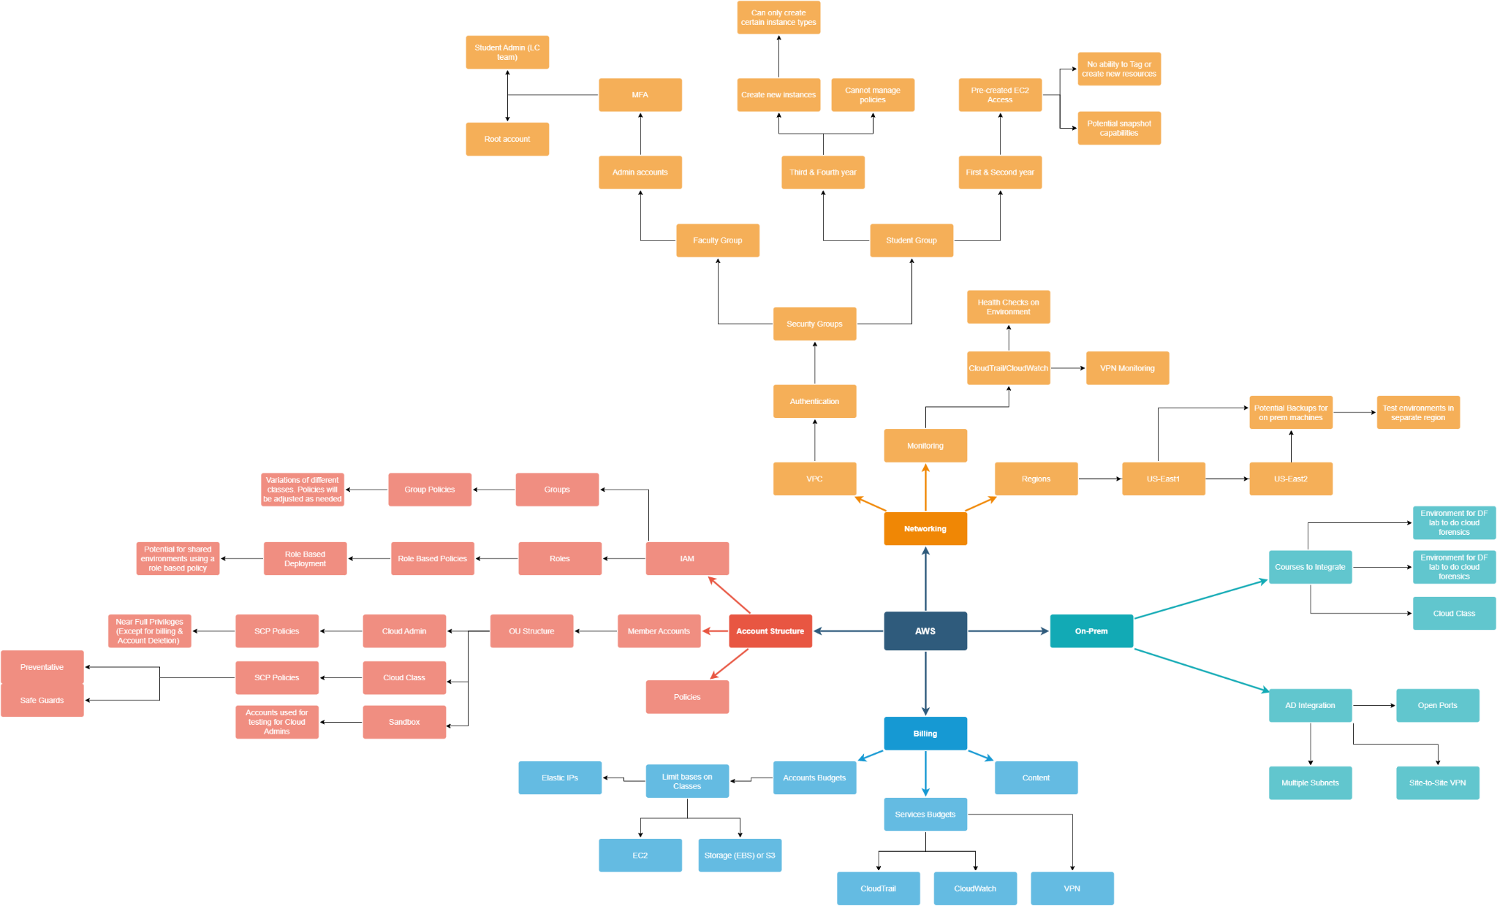

Slide 3
Research Phase

Slide 4
Creating an Organization
Policies
VPC
IAM
How we are going to secure the environment
Where we are going to be hosting our instances
Users, Groups, Roles

Slide 5
Policies
Service Control Policies
IAM User & Group Policies
Tagging Policies

Slide 6
VPC
AD Connector
VPN
Security Groups

Slide 7
IAM
Users
Groups
Role

Slide 8
Production Phase

Slide 9
OU Structure
Root
Cyber Admin
The top of the Organizational Structure
The Cloud Administrators
Cloud Class
Sandbox
Used for exploring the cloud
A testing environment for admins to test policies and various services

Slide 10
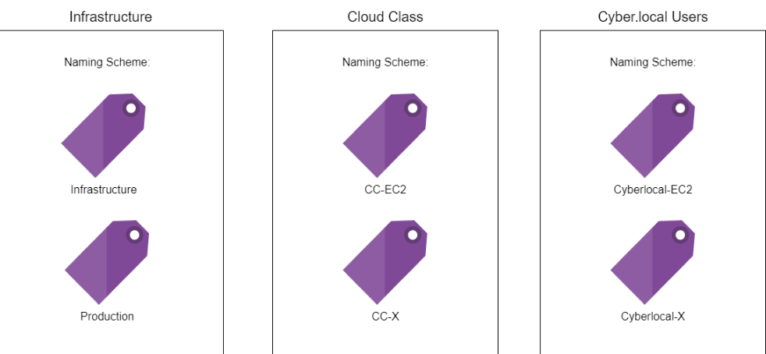
Tagging Scheme

Slide 11
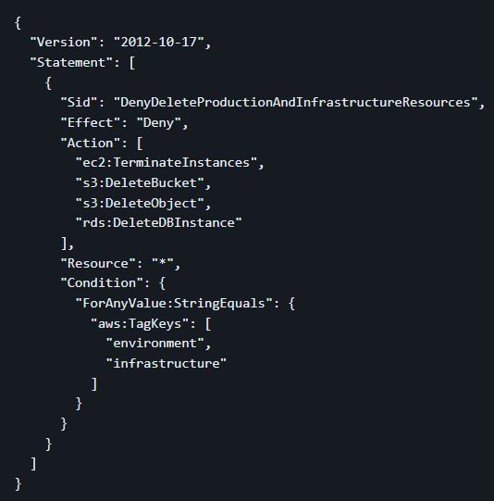
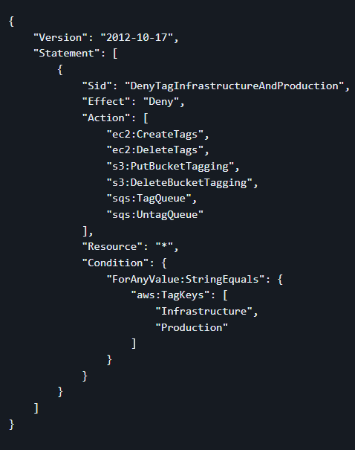
Sample Tag Policies

Slide 12
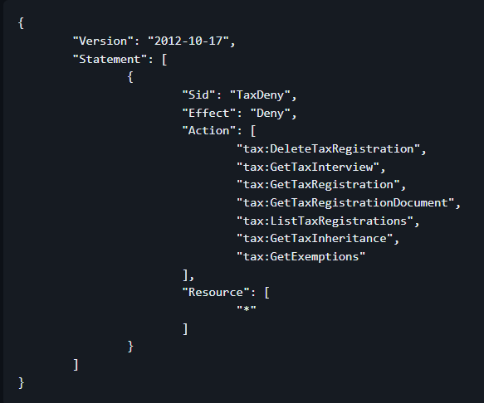
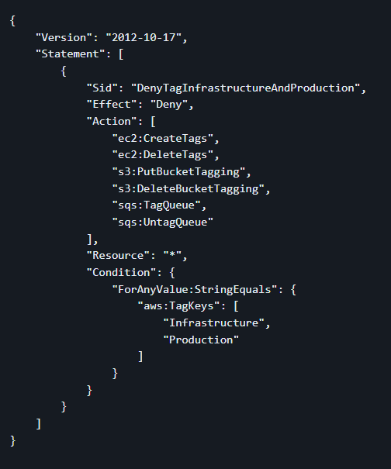
Sample Service Control Policies

Slide 13
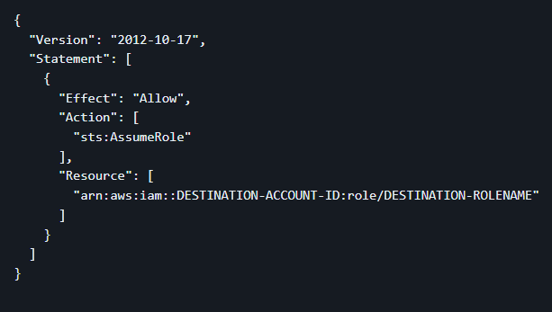
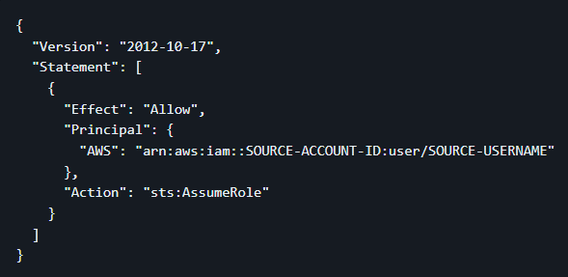
Sample Role Policies

Slide 14
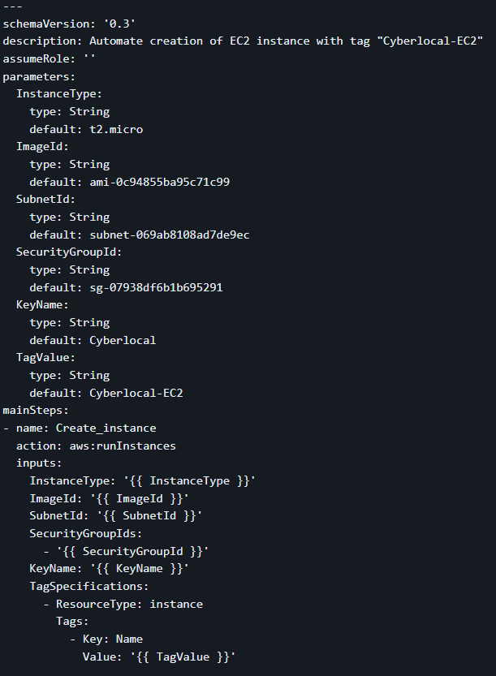
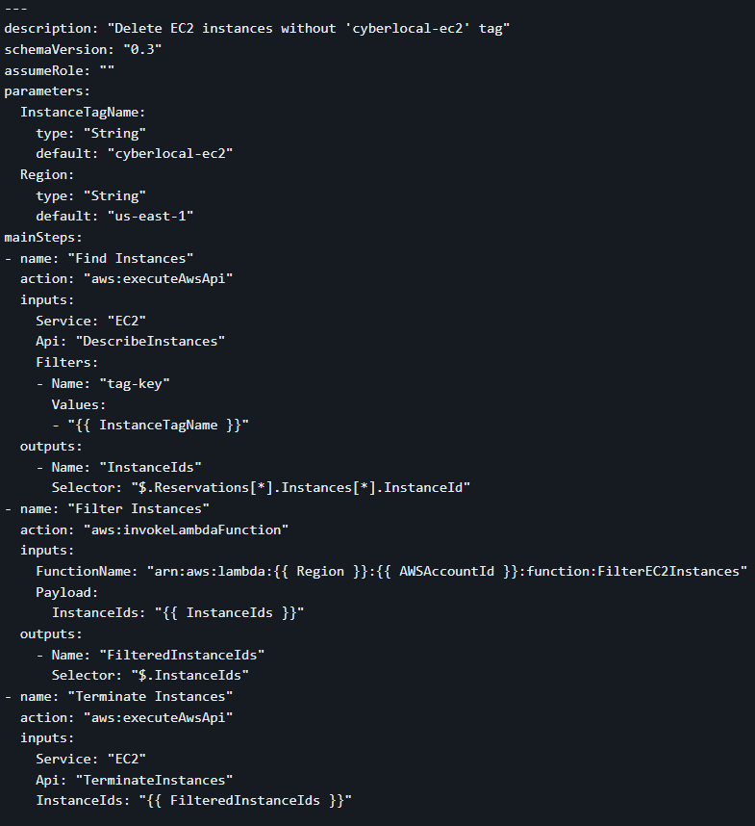
Automation

Slide 15
Conclusion Phase

Slide 16
Overall
Although the project isn’t going into production. We have set the basis for a AWS team in the future. Our research and development will be passed down to future students to build a cyber.local cloud hybrid.
Currently we have a test environment with iam users, an Ad connection, and other features.

Slide 17
My takeaway
A big project such as integrating a hybrid cloud solution to an already well established infrastructure is quite the challenge. It requires in-depth planning, clear communication with clients and sys admins, and overall a magnitude of knowledge of the cloud.

Slide 18

Thank
You

Slide 19
MY REFERENCES
Github
Sprint Tasks
Specific Sources
https://github.com/Kahuna915/Capstone-Cloud-Integration/wiki/Documentation
https://github.com/users/Kahuna915/projects/2
https://github.com/Kahuna915/Capstone-Cloud-Integration/wiki/References

